Slide 1

Mini Firewall
The Mini Firewall API is a simple command-line utility that allows users to manage a firewall's configuration by modifying port lists and DNS blacklists. The tool provides options to view, add, and remove entries from these lists, helping to control network access and traffic filtering

Slide 2

What is a Kernel Module?
Imagine your computer’s operating system as a big control room, and the kernel is the main control system running everything. It manages all the important tasks that let your computer work, like interacting with hardware (e.g., your keyboard, mouse, or network) and running programs.

Slide 3

What Does Our Kernel Module Do?
Our kernel module acts like a security guard for your computer’s internet connection. It monitors the data flowing in and out of your computer, focusing on specific areas like ports (which are like entry and exit points for information) and websites.

Slide 4
What Does Our Kernel Module Do?
Our kernel module acts like a security guard for your computer’s internet connection. It monitors the data flowing in and out of your computer, focusing on specific areas like ports (which are like entry and exit points for information) and websites.
For example, if there’s a list of websites that we don’t want people to visit (like unsafe or inappropriate sites), the kernel module can check every request to visit those sites and block access if necessary. Similarly, if we only want to monitor certain types of internet traffic (like the kind used for browsing or specific applications), it keeps an eye on that traffic to ensure everything is safe and functioning as intended.

Slide 5
Client Features
Sniffing Configuration Tools:
View, add, or remove port entries from a port list (portlist.txt).
These ports are monitored by the firewall for network activity.
Blocker Configuration Tools:
View, add, or remove DNS entries from a blacklist (blacklist.txt).
These DNS entries represent domains that are blocked by the firewall.

Slide 6

Connection with modules
Our solution to connect the kernel moduls with the client is using the file system.
In this way we not only connecting the client with the moduls,
But we also save the configuration to the next time the computer boots.
client
Portlist (file)
Sniffer
Blacklist (file)
Blocker

Slide 7
Use Of Files
./api_menu.c: Main source file containing the CLI program logic.
/etc/portlist.txt: A text file that stores the list of ports being monitored by the firewall.
/etc/blacklist.txt: A text file that stores the list of blacklisted DNS entries.
./blocker/DnsBlocker.c: Source file responsible for handling DNS blocking functionality.
./sniffer/PortSniffer.c: Source file responsible for port sniffing and network monitoring.

Slide 8
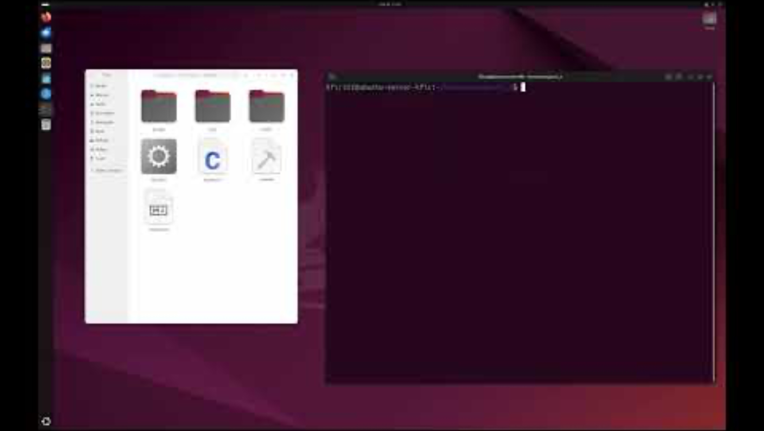
The FireWall and Sniffer in Action

Slide 9
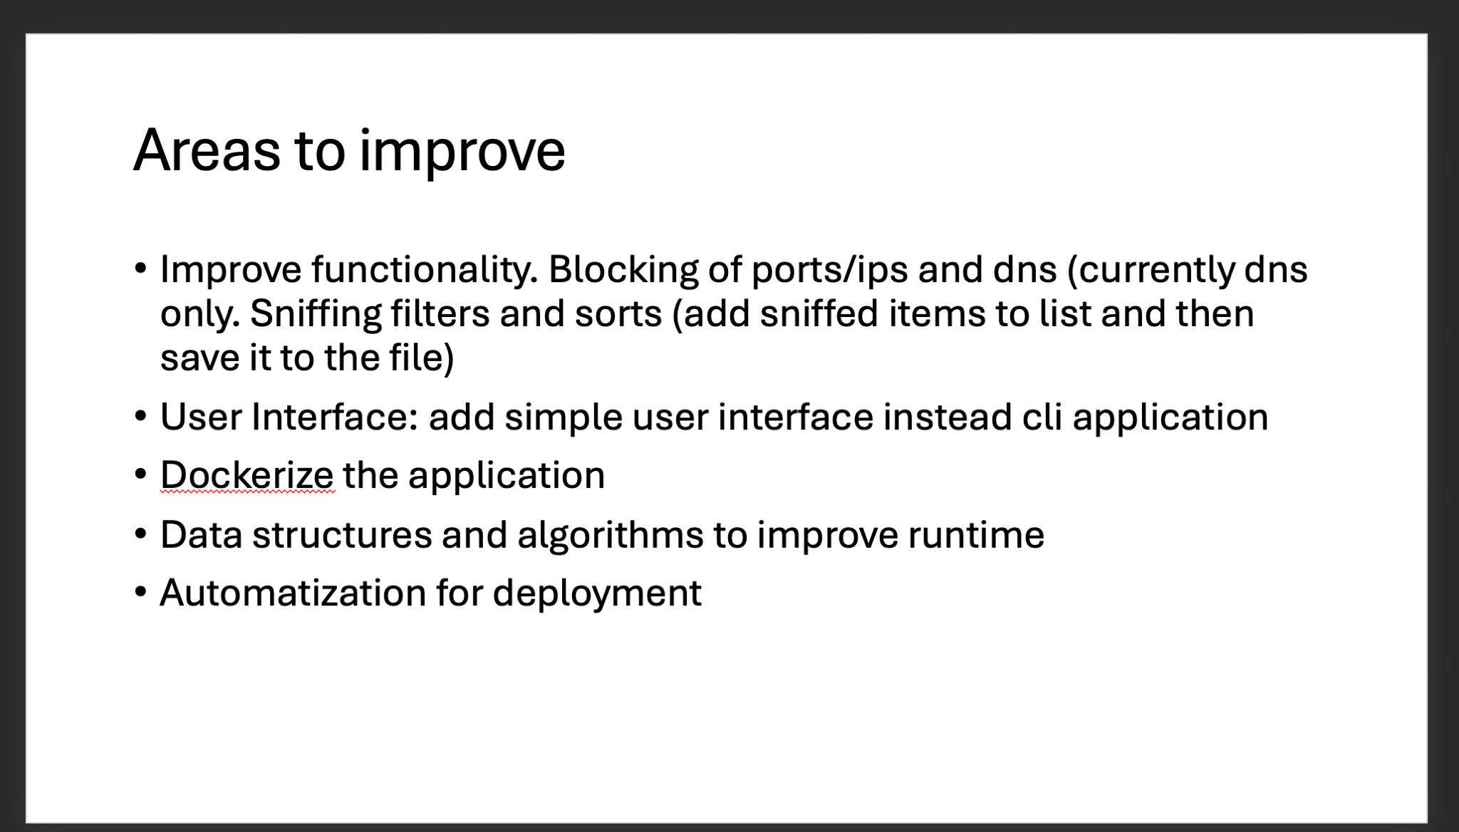

Slide 10


Thank You For Your Time

